Slide 1
RAID I/O pattern 분석
김서진

Slide 2
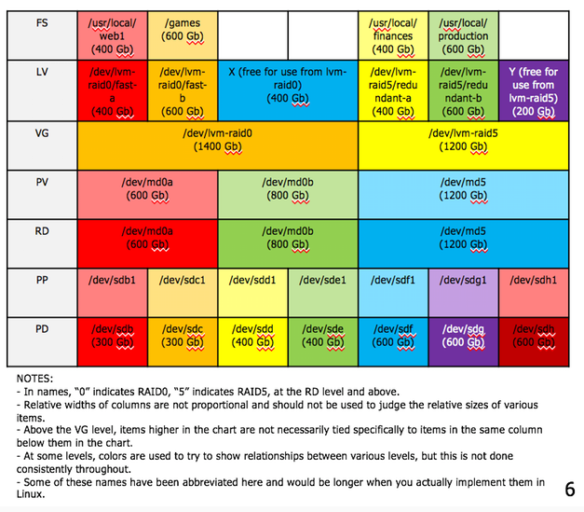
LVM on top of RAID
Filesystem(FS)
/usr/local/lvm0
Logical Volume(LV)
/dev/lvm-raid0/lvm0
Volume Group(VG)
/dev/lvm-raid0
Physical Volume(PV)
/dev/md0
RAID device(RD)(via mdadm if Linux SW RAID)
/dev/md0
Physical Partition(PP)
/dev/sdb1
Physical Device(PD)
/dev/sdb

Slide 3
실험세팅
Fio benchmark v2.1.3
File size: 5GB
Request size:4K , randwrite
File system: ext4 filesystem
Storage:
Sda: Intel 540s 128GB
Sdb: Intel 540s 128GB
Sdd: Intel 540s 256GB

Slide 4
RAID Device Layer(MD0)
 | Linear SSD2 | Linear SSD3 | RAID0 SSD2 | RAID0 SSD3 | RAID5 SSD3
I/O count | 4 | 4 | 4 | 4 | 2898241
Latency | 0.001007 | 0.000961 | 0.000967 | 0.001251 | 0.00000158
Write size | 8 | 8 | 8 | 8 | 8
RAID Device Layer(MD0)에서
Write size는 8 Block으로 모두 같음에도 불구하고, RAID5의 Latency는 급격히 감소, I/O count는 급격히 증가한다.

Slide 5
Linear
 | SSD 2개 | SSD 3개
I/O count | 248 | 340
Latency | 0.20502 | 0.042406
write size | 13.97736 | 12.94382
Linear하게 연결한 SSD array에서, 모두 첫번째 physical device인 sda1에 write 되었지만, I/O count와 Latency는 다르게 나타났다.
I/O count는 증가했지만, write 되는 size와 Latency는 감소했다.

Slide 6
RAID0, DISK2
 | sda1 | sdb1
I/O count | 204 | 115
Latency | 0.0051 | 0.0875
write size | 12.9455 | 14.9565
Striping 방식을 사용하는 RAID0 에서, 각 Physical device에 write 되는 수는 크게 차이 났다. (2배 가량)
I/O Count는 적어졌지만, Write 의 size는 증가해서 관련이 있을까 생각했지만 (다른 실험으로 확인했을때) 연관이 없는 것으로 나타났다.

Slide 7
RAID0, DISK3
 | sda1 | sdb1 | sdd1
I/O count | 175 | 19 | 94
Latency | 0.0202 | 0.0161 | 0.0772
Write size | 15.2686 | 14.6087 | 12.9811
③
④
①
⑤
②
RAID0에서 각각 고르게 write 될거란 예상과 달리, device 별로 load balancing이 잘 이루어 지지 않는 것을 확인할 수 있었다.

Slide 8
RAID5, DISK3
 | sda1 | sdb1 | sdd1
I/O count | 4898511 | 4895736 | 31373905
Latency | 0.00000118 | 0.00000071 | 0.00000709
write 크기 | 13.5300 | 13.5354 | 23.8045
RAID5에서도, 각각의 Physical device별로 I/O count 및 write 되는 양에 큰 격차가 존재했고, latency 또한 마찬가지였다.

Slide 9
Load balancing 원인 및 해결방안
원인
MDADM tool
각각 SSD 내부 문제
SSD 종류
줄일 수 있는 방안?
Filesystem
MDADM code 수정
Write 어떻게 되는지

Slide 10
Hardware RAID
Boosts system performance for backups and restoration, (especially in legacy equipment with limited processing power, by adding DRAM cache memory to the system.) Translates to less strain on the system when writing backups, and less downtime when restoring data.
Adds RAID configuration options that may otherwise be unavailable using just the motherboard—like RAID 5/6, for example, which provides one and two drive failure tolerance.
Protection against data corruption resulting from a loss of power during the backup process. Battery backup units (BBU) or onboard Flash memory in RAID cards provide the extra fail-safes here.
Adds system compatibility with enterprise SAS HDDs, which are designed for 24/7 operation and have extra error correcting features compared to consumer-grade SATA III HDDs.

Slide 11
Software RAID
최신식 multi-core server CPU는 많은 system 제약 없이도 백업 및 복구 작업을 실행할 수 있을 만큼 강력하다. Hardware RAID를 사용함으로써 얻을 수 있는 백업 및 복구 성능 향상이 매우 미미할 때.
Software RAID is used exclusively in large systems (mainframes, Solaris RISC, Itanium, SAN systems) found in enterprise computing.
SMBs using NAS devices for backup and restore purposes will find many software-RAID based options: Netgear ReadyNAS; Synology DiskStation(DS), Buffalo TeraStation, are examples.
Open source인 Software RAID를 사용하는 경우, Flexibility를 얻을 수 있다. Ex. Linux Mdadm
Software RAID 지원가능한 Hypervisors를 사용하는 경우 ex. Hyper-V -> Storage Space 사용

Slide 12
Hardware RAID and SSD arrays
System administrators have reported inconsistent performance for certain hardware RAID setups that use flash storage (SSD) arrays. Older RAID controllers disable the built-in fast caching functionality of the SSD that needed for efficient programming and erasing onto the drive. Most current generation RAID controllers give users the option of re-enabling SSD disk caching to alleviate this.
Having an all-flash storage array set up for RAID 5 provides substantial performance gains compared to a HDD array.

Slide 13
HW RAID SW RAID
The type of RAID best suits data backup needs will vary from system to system. Hardware RAID is more common in Windows Server environments, wherein its advantages are better realized. Software RAID is more prevalent in open source server systems, wherein its flexibility and comparative low cost of entry make it an attractive option. Both options are completely viable; answering the hardware RAID vs Software RAID question depends on assessing the IT infrastructure—the sever hardware and system administrators operating it—to determine what makes the most sense for any organization.

